Slide 1
BLOG
Image here of the home
NOSQL Databases (0423 L 777), SoSe 17
10.07.2017, Berlin
Akarsh Seggemu
Budankailu Sameer Kumar Subudhi Sonali Bhatnagar
Image here of the create blog post

Slide 2
Agenda
1.
Plan
2.
Databases
3.
Live demo

Slide 3
Plan
Task | Week no.
Kick-off meeting | Week 1
Literature research | Week 1, 2
Initial implementation | Week 2
Pitch presentation | Week 2
Reviews of initial implementation | Week 3
Final Implementation | Week 4,5
Final presentation | Week 6

Slide 4
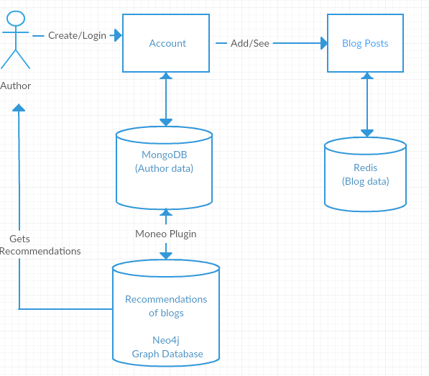
Application Architecture

Slide 5
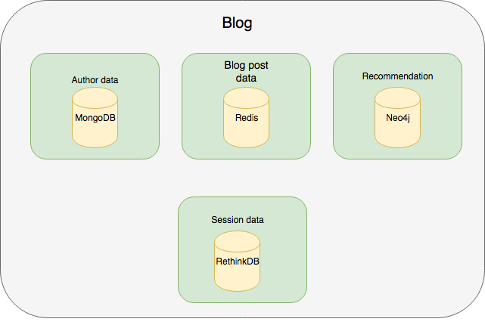
Databases: Architecture

Slide 6

NOSQL Databses: MongoDB

Slide 7

NOSQL Databses: Mongoose (ORM)

Slide 8

NOSQL Databses: moneo (plugin/middleware)
+ moneo =
Schema
Add nodeProperty: true
Add Schema.plugin(moneo)
Data Model

Slide 9
NOSQL Databses: Neo4j
Recommendation

Slide 10

NOSQL Databses: Redis
Stores Blog Data: Blog Title,
Category,
Blog Content
Data is key-value pair with Key as Id and Value as Blog Data

Slide 11
Redis : Problems Encountered
Data can only be stored as key value pairs
(Blog Title, Content)
What if we wish to store more fields like Category, Username?
Solution : Store data in an array

Slide 12
Redis : Problems Encountered
Unable to show latest blogs on screen when opens application first time
Open issue in Redis where first time array returns a blank value
Temporary Solution: Added an extra reload on main page

Slide 13
Advantages of Using Redis
Fast retrieval of blog data as compared to Mongo
Supporting wide variety of data types
Future advancements in application can add more complex data types like list, sets etc

Slide 14

NOSQL Databses: RethinkDB
Session storage

Slide 15

NOSQL Databses: Thinky (ORM)

Slide 16
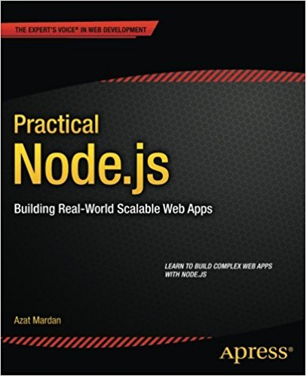

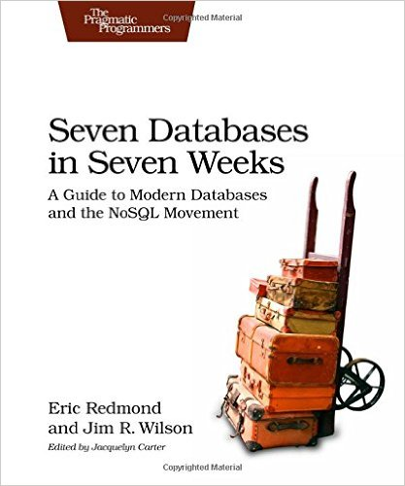


Literature
TUB - Library ST 250 J35 316
HUB - Library
ST 250 J35 B845
TUB – Library
ST 270 243
HTW - Library ST 270 S124
HUB – Library
ST 270 F785

Slide 17
Live demo

Slide 18
Q & A ?
Thank you | Danke schön |
ధన్యవాదాలు

